Slide 1
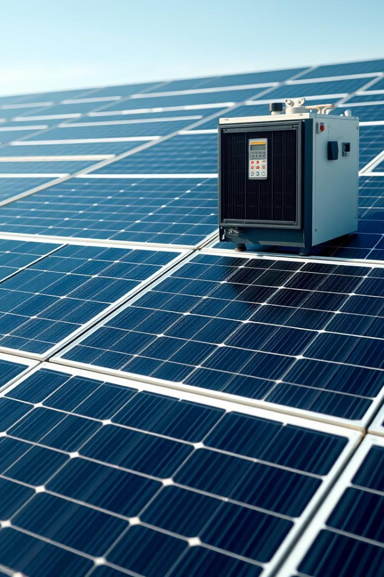

Gopalganj Science and Technology University.
Department of Electrical & Electronic Engineering.
Minimization of Leakage Current by Frequency Range Determination in Transformer-less Inverters for Photovoltaic On Grid System
Presented by
Robiul Hosen
Razowan Kabir
Most. Murshida khatun
Pantho Mondal
Date: 05/05/2025

Slide 2
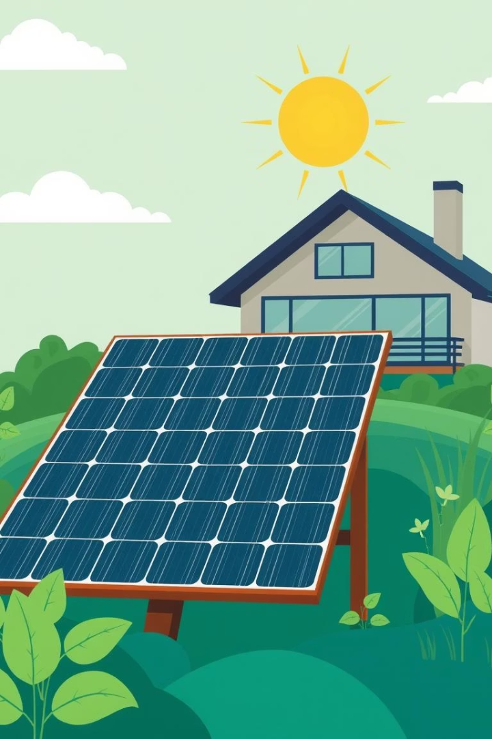
🔌What is a Transformer-less Solar Inverter?
A device that converts solar panel power (DC) to usable home power (AC) without a transformer.

Slide 3
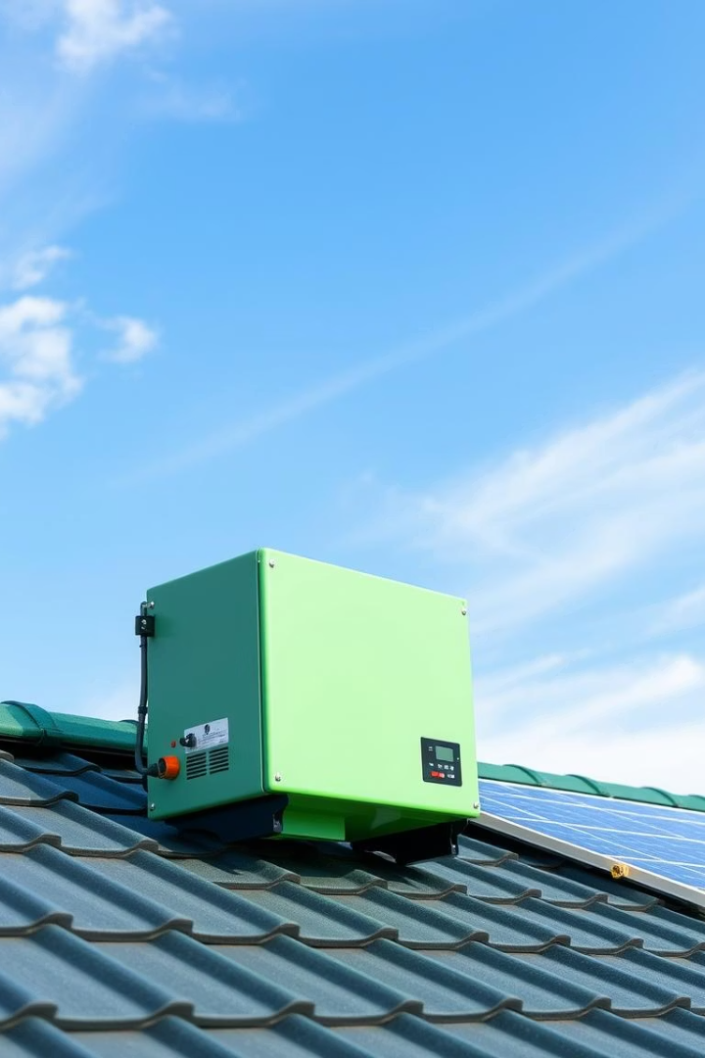


Why Transformer-less?
Advantages
Compact design, high efficiency, and cost-effectiveness.
Disadvantage
No galvanic isolation leads to leakage currents.

Slide 4


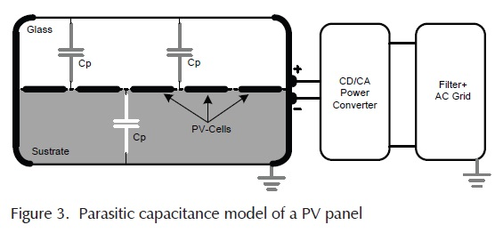
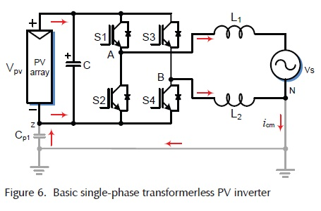
What is Leakage Current ?
⚡ Leakage current is unwanted electricity that flows from solar panels to the ground.
🔋 It happens in transformer-less inverters because there's no full isolation between DC and AC sides.
🌞 Solar panels have a small natural link (capacitance) to the ground.
🔁 When voltage changes, current flows through this link — this is leakage current Produce.

Slide 5

Leakage Current Issues in PV Cells (As per IEEE Safety Standards)
Device Tripping
EMI (Electromagnetic Interference)
Safety Hazards
Unexpected system shutdowns due to leakage detection.
Risk of electric shock and fire.
Affects performance of nearby electronic devices.

Slide 6
Leakage Current Influencing Factors and Mitigation
Parameter
Effect on Leakage Current
IEEE/IEC Reference
Mitigation Strategy
Switching Frequency
↑ ↓ Frequency → ↑ Parasitic coupling (2-3× leakage)
IEEE 1547-2018
Optimize PWM; use SiC/GaN devices
Temperature
↑ 10°C → ~2× leakage
IEC 62478
Heat sinks, active cooling, PCB layout optimization

Slide 7
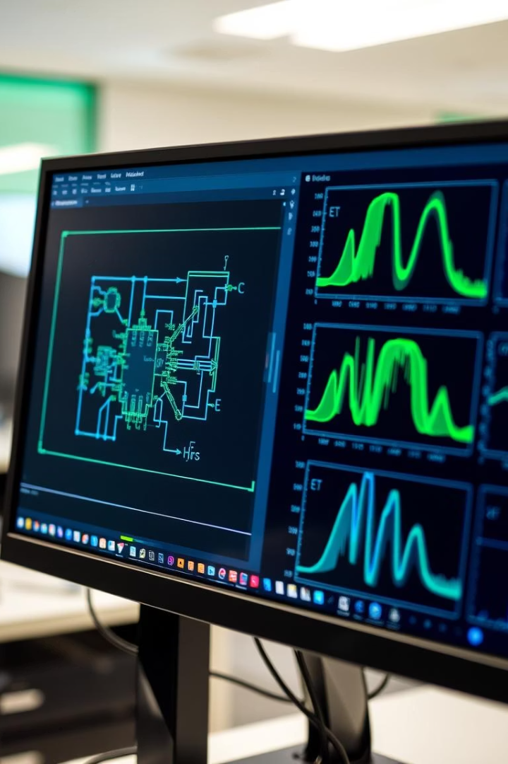
Scope of the Study
1
Simulation Environment
2
Frequency Analysis
MATLAB used for detailed circuit modeling.
Examined frequency range impacts from 10 to 50 kHz.
3
Thermal Evaluation
Assessed thermal stresses on power devices under load.

Slide 8
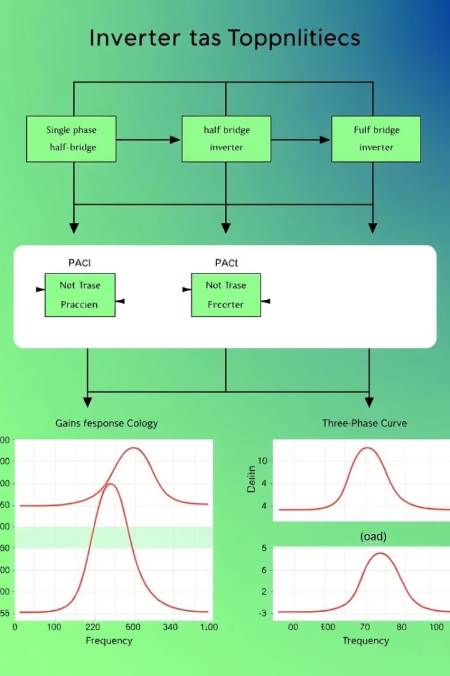

Research Objectives
Simulate Topologies
HERIC, H5, H6, and Neutral Point Clamped (NPC) models.
Frequency Optimization
Identify ideal switching frequency ranges.
Topology Comparison
Evaluate leakage and thermal performance differences.
Thermal Strategies
Develop recommendations to reduce device heating.

Slide 9
Step-by-Step Approach
Literature Review
1
Analyze previous findings to identify knowledge gaps.
2
Circuit Simulation
Build and test inverter models under varying conditions.
Leakage Analysis
3
Quantify leakage currents across topologies and frequencies.
4
Thermal Analysis
Examine device temperature profiles and stresses.
Standards Validation
5
Ensure compliance with IEC 62109 and IEEE 1547.

Slide 10
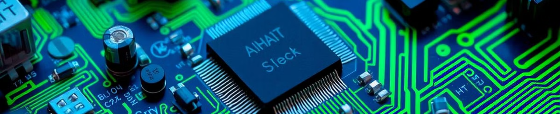




What We Expect
Validated Model
Frequency-Leakage Graphs
Thermal Analysis
Standards Compliance
Confirmed performance of HERIC inverter design.
Thermal maps guiding effective cooling methods.
Visualize leakage current trends and optimal points.
Alignment with IEC 62109 and IEEE 1547 for safety.

Slide 11
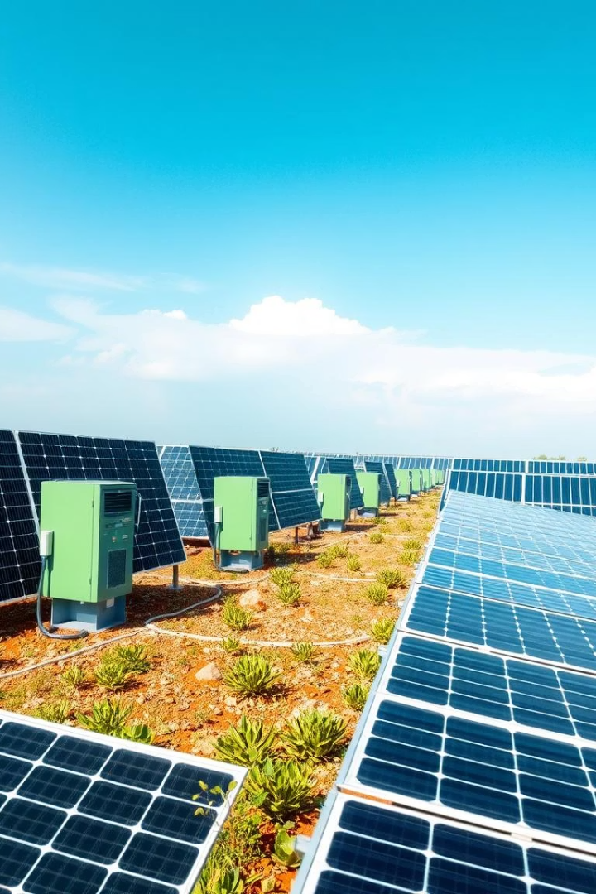
Conclusion
Best Topology
Optimal Range
HERIC topology offers superior leakage current reduction.
10–20 kHz switching frequency balances efficiency and safety.
Design Guidelines
Recommendations provided for safer photovoltaic system design.

Slide 12

Thank You…

